Slide 1
GEOS-CARB: A Framework for Monitoring Carbon Concentrations and Fluxes
Steven Pawson¹, Lesley Ott¹, David Baker², George J. Collatz¹, Janusz Eluszkiewicz³, Watson Gregg¹, Stephan R. Kawa¹, Thomas Nehrkorn³, Tomohiro Oda², Chris O’Dell², Cecile Rousseaux^{1,4}, Andrew Schuh², Brad Weir^{1,4}
¹NASA Goddard Space Flight Center
²Colorado State University
³Atmospheric and Environmental Research
⁴Universities Space Research Association

Slide 2
GEOS-Carb Phase 2a Goals
Move from CMS Flux Pilot Project (FPP) towards global, integrated, carbon modeling
Extend land and ocean fluxes and evaluation over a longer time period (2003-2013)
Incorporate new, high resolution fossil fuel flux estimates
Evaluate flux estimates using atmospheric CO₂ observations
Apply carbon data assimilation techniques to inform source and sink estimates
Develop and evaluate CO₂ inversion techniques
Flux Pilot Project
Prototype Models
GEOS-Carb I
Maturation, Integration of models
GEOS-Carb II
Deliver mature flux and concentration products

Slide 3
GEOS-Carb Modeling System
Atmospheric Observations
Flux Assessment Using Atmospheric CO₂
CO₂ Observations
In situ, TCCON,
GOSAT, OCO-2
Assimilation of Satellite CO₂ Observations
Maturation of Inversion
Techniques
MERRA
Reanalysis
Meteorology
GEOS-5 Atmospheric CO₂ Simulations
CASA-GFED
NOBM
ODIAC
Model
Land Flux
Ocean Flux
Fossil Fuel
Product
fPAR, Fires
Ocean Color
Night Lights
Data

Slide 4
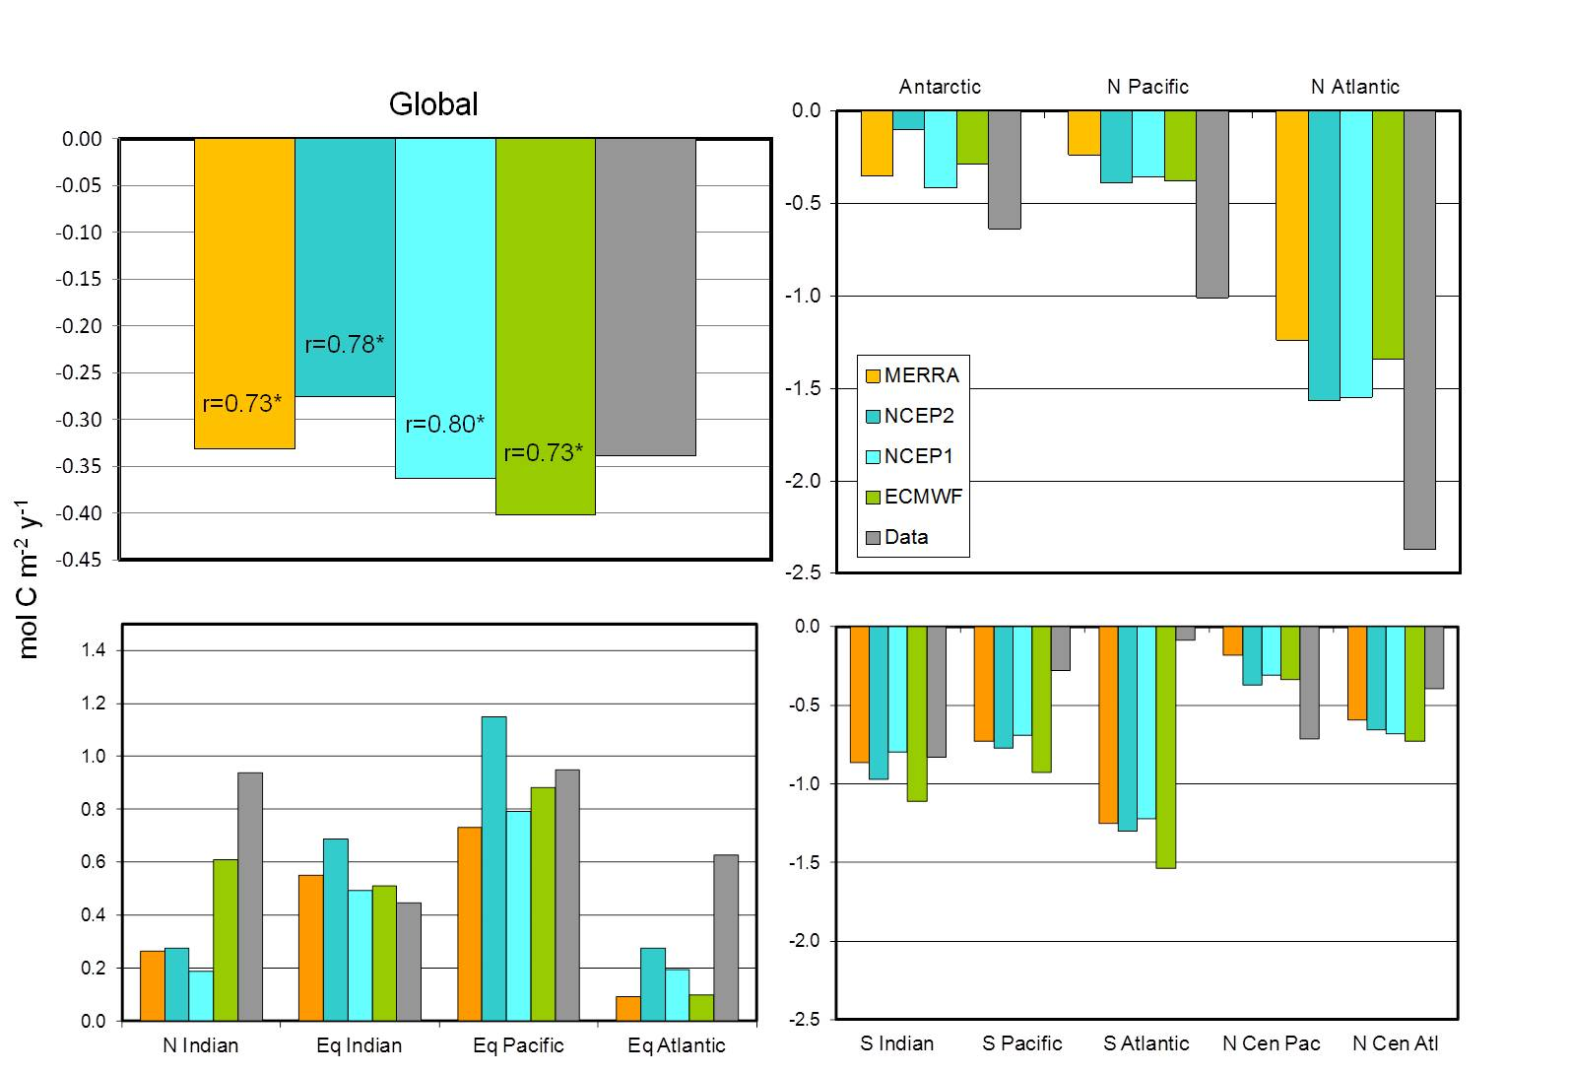
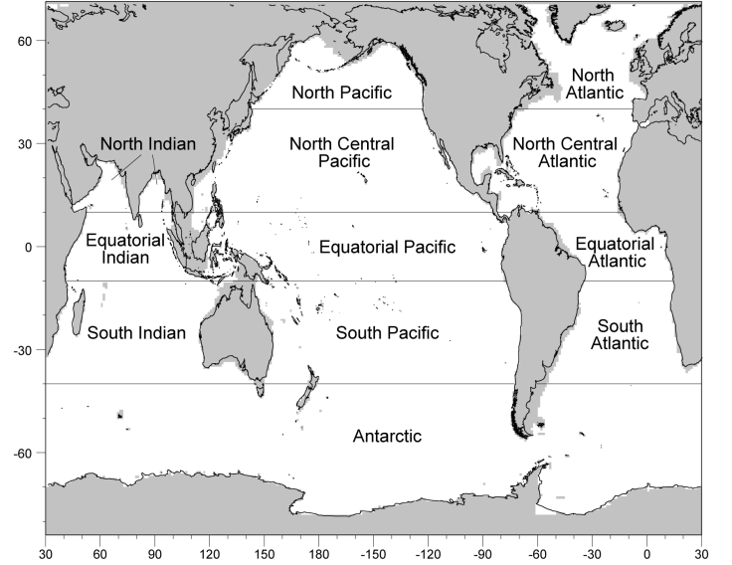
Ocean carbon flux – assessing uncertainty due to meteorological forcing
4 reanalyses datasets used to force the NOBM to estimate FCO₂
Global FCO₂ were insensitive to the choice of forcing reanalysis
All global FCO₂ estimates were within 20% of in situ estimates
High latitudes and tropics had largest ranges in estimated FCO₂ among the reanalyses
No individual reanalysis was uniformly better or worse in the major oceanographic basins.
Gregg W.W., N.W. Casey and C.S. Rousseaux, 2014. Sensitivity of Simulated Global Ocean Carbon Flux Estimates to Forcing by Reanalysis Products. Ocean Modelling, 80, 24-35

Slide 5
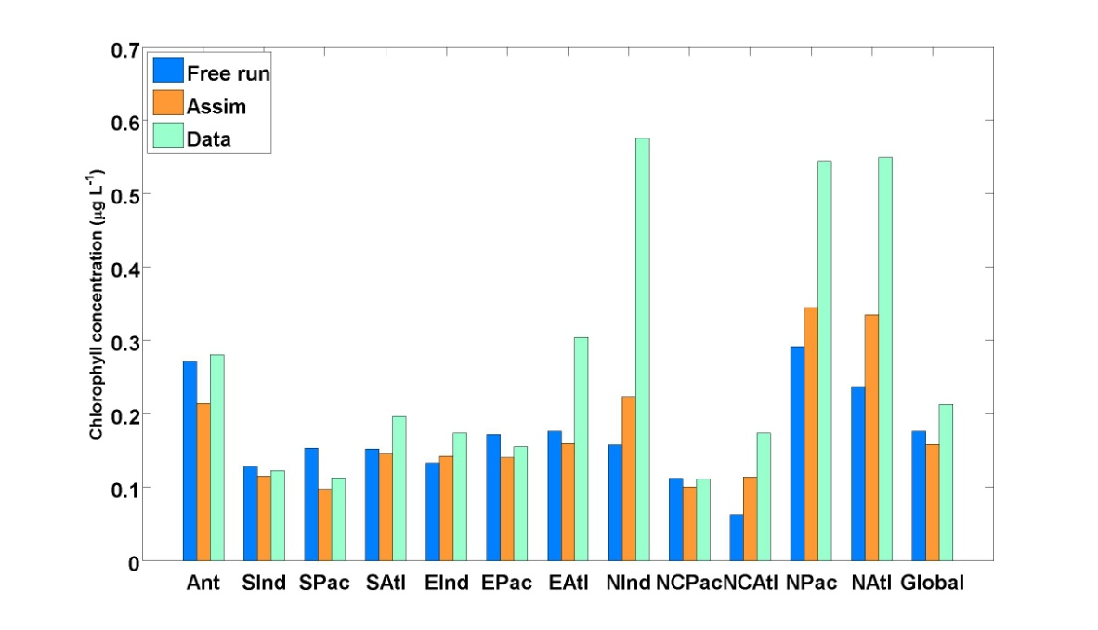
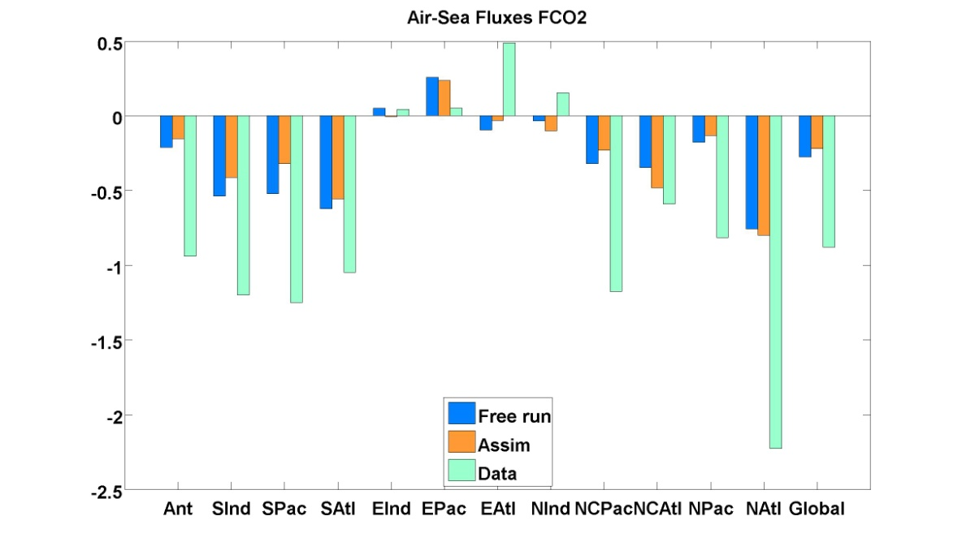
Ocean carbon flux – Effects of chlorophyll assimilation on CO₂ flux estimates
Assimilation of chlorophyll decreases the uncertainty in chlorophyll concentration
Global FCO₂ produced in the free-run and after assimilation were within -0.6 mol C m⁻² y⁻¹ of the observations.
The FCO₂ values were not strongly impacted by the assimilation, and the uncertainty in FCO₂ was not decreased
Chlorophyll a
Air-Sea Fluxes FCO₂
Rousseaux C.S. and W.W. Gregg, 2014. The Effects of Chlorophyll Assimilation on Carbon Fluxes in a Global Biogeochemical Model. NASA Technical Report Series on Global Modeling and Data Assimilation, NASA TM-2014-104606, Vol. 33, 22 pp.

Slide 6
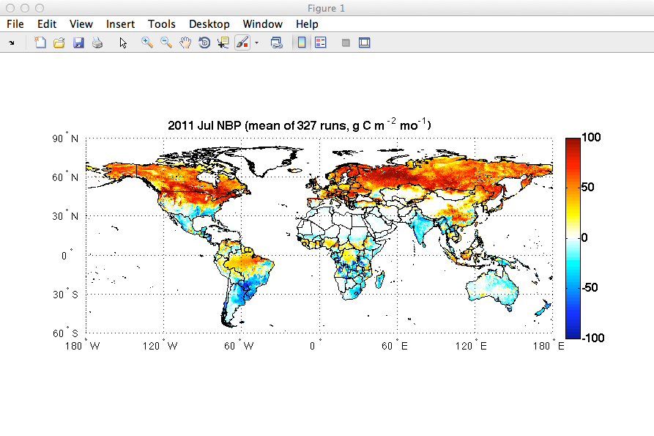
Land carbon flux – Development and evaluation of CASA/GFED3
Satellite data constraints:
-Seasonal/interannual phenology: monthly
GIMMS AVHRR NDVI
-Woody allocation: MODIS Vegetation Continuous
Fields
-Vegetation class: MODIS Land Cover Type
-Seasonal/interannual burned area (daily): MODIS
Surface Reflectance & Fire detections
Inputs: Meteorology (MERRA), Satellite derived vegetation states,
Satellite derived fires/burned area
Outputs: 1/2º monthly NPP, Rh, Fire emissions (daily)
Outputs scaled to 3 hourly 1x1.25º GPP, RE, and fire for transport model
Data available for 2003-2013 from link on CMS website. More details in J. Collatz’s talk and poster.
Atmospheric Carbon
NPP
Live Carbon Pools
Fire
Mortality
Dead Carbon Pools
Fire
Respiration

Slide 7
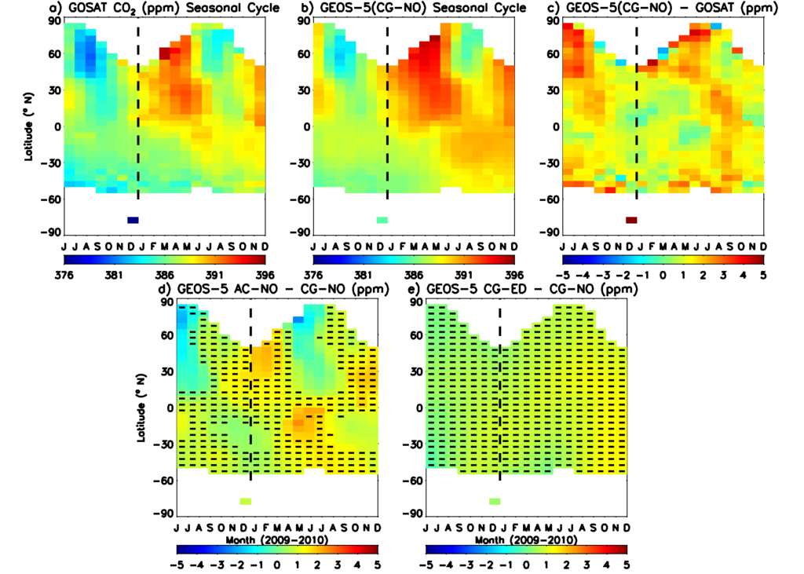
Evaluation of carbon fluxes using atmospheric CO₂ observations
GOSAT zonal
mean XCO₂
GEOS-5 zonal
mean XCO₂
Difference due to
land flux estimate
Sim - Obs
Completed manuscript assessing the ability of different CO₂ measurements to detect differences between flux estimates (Ott et al., in revision for JGR, 2014)
Longer simulations facilitate evaluation of interannual variability represented in fluxes. Example shows simulated and observed column CO₂ at the Park Falls, WI TCCON site
Assessment of Interannual Variability in CASA-GFED3

Slide 8
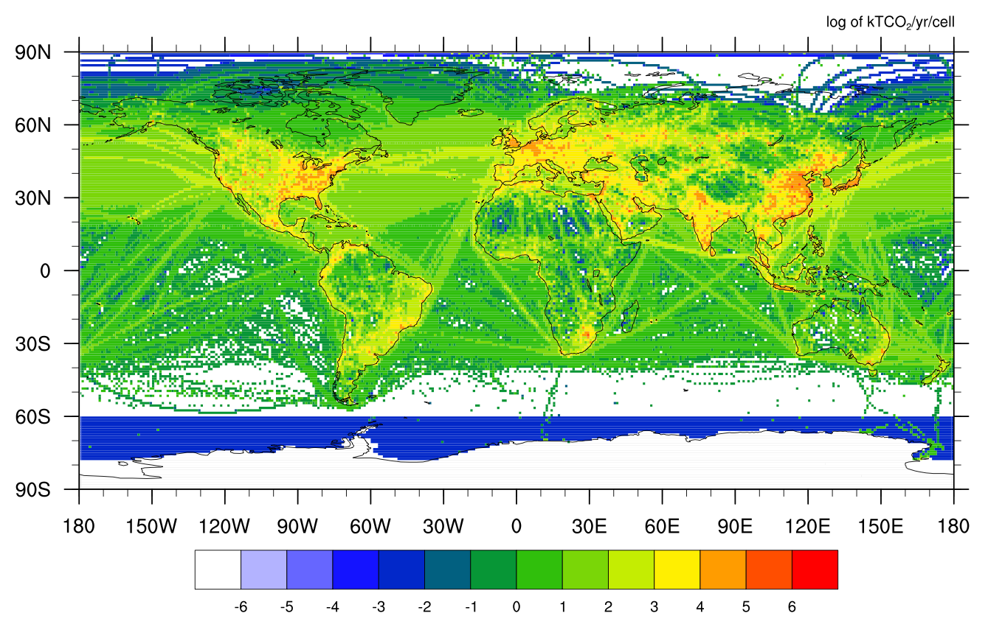
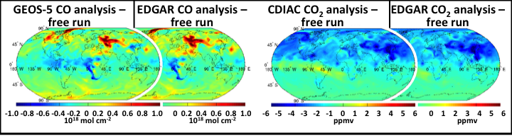
Refining tools that inform flux estimates – carbon data assimilation
2013 ODIAC Emissions
GEOS-Carb sought to integrate higher resolution fossil fuel emissions datasets into the GEOS- modeling system
CO and CO₂ assimilation experiments using different combinations of fluxes help to identify causes of disagreement between models and observations
Assessment of Flux Errors Using Data Assimilation

Slide 9
Refining tools that inform flux estimates – inversion methodology
Ported and tested 4DVar inversion code developed at CSU to NASA high-end computing systems – development will support higher resolution inverse methods (more details in D. Baker talk tomorrow)
UNCERTAINTY REDUCTION, monthly flux estimates
NOAA in situ + TCCON
GOSAT 3-point scan
ASCENDS 1.57 μm, 0.5 ppm RRV
OCO-2 best guess
ASCENDS 2 μm, 0.5 ppm RRV
ASCENDS 2 μm, 0.25 ppm RRV

Slide 10
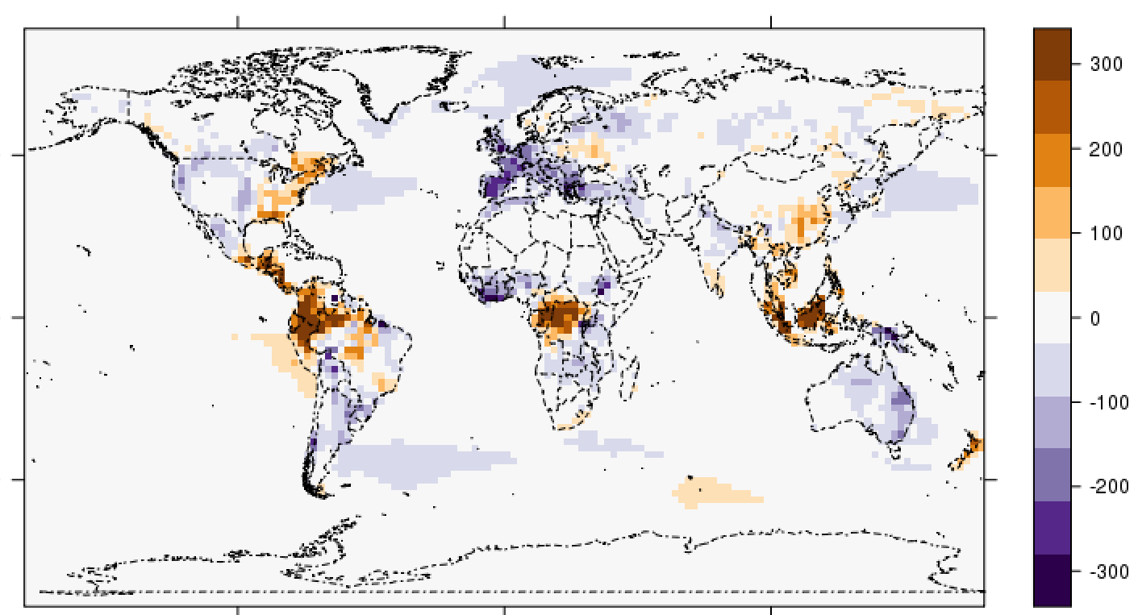
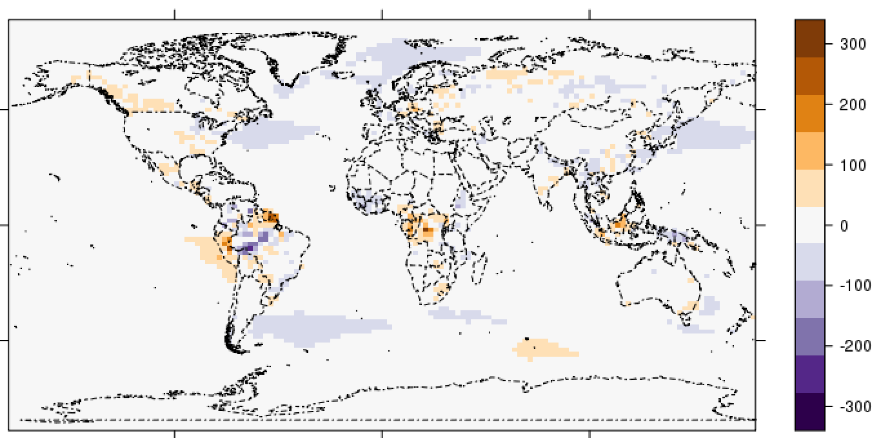
Refining tools that inform flux estimates – inversion methodology
Results of ‘bias-unaware’ inversion
Estimated Flux - Truth
GEOS-Carb also supported development of techniques to minimize the impact of observation bias on top-down flux estimates
In these OSSEs, a hypothetical tropical sink is diagnosed in the wrong locations because of a small land-ocean bias contained in the psuedo observations (top)
Bottom plot shows that when the bias is solved for along with flux corrections, the true pattern of fluxes is better diagnosed
Results of ‘bias-aware’ inversion

Slide 11
Conclusions
GEOS-Carb seeks to continue the progress of the FPP toward integrated, observation informed modeling tools
Land and ocean fluxes are available for the years 2003-2013. ODIAC fossil fuel emissions available upon request.
We continued to use atmospheric transport models and data to evaluate and refine flux estimates
Also introduced CO and CO₂ data assimilation using multiple emissions datasets to identify causes of model-data discrepancies
Worked to mature inversions techniques by developing new methods to treat observation biases, building towards higher resolution inversions in the future
GEOS-Carb II (2014 funded project) will build upon the foundation of the FPP and GEOS-Carb (2012) to provide model-based flux and concentration products to the carbon monitoring community (see L. Ott presentation Friday)

